Slide 1
How to
Save Money

Slide 2
How to Save Money
Part 1
Part 2
June Expense
6 months Expense

Slide 3
How to Save Money Part 1
Task 1 | Task 2 | Task 3 | Task 4
How much is spent for each category Visually represent the amount spent against each category is what percentage of the total expense amount | How much is spent on different items of each category Visually represent the amount spent on different items of Entertainment and Tickets and bills category | How many times money has been spent against different items of each category Filter the data to display the data for Grocery items and Shopping items | What amount is spent on each item of the categories with highest and 2nd highest expense amount Visually represent the data with data bars

Slide 4
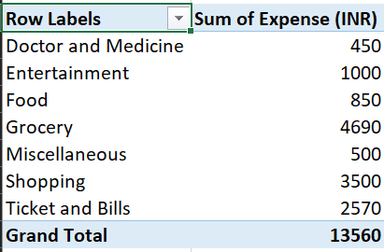
Task 1

Slide 5
Task 2
Row Labels | Sum of Expense (INR)
Doctor and Medicine | 450
Mother's Medicine | 450
Entertainment | 1000
Movie | 1000
Food | 850
Chips and Fries | 250
Online Food Order | 600
Grocery | 4690
Beverages | 250
Bread and bakery | 500
Foodgrains and cereals | 1050
Fruit | 650
Oil and spices | 550
Vegetables | 1690
Miscellaneous | 500
Sister's birthday gift | 500
Shopping | 3500
Shoes | 1000
Tshirt and Jeans | 2500
Ticket and Bills | 2570
Electricity bill | 370
Gas | 850
House help | 1000
Railway monthly ticket | 350
Grand Total | 13560

Slide 6
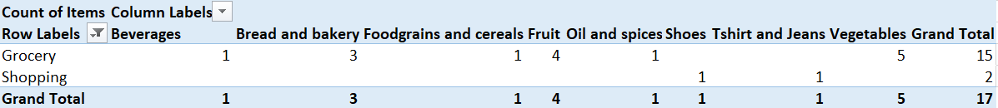
Task 3

Slide 7
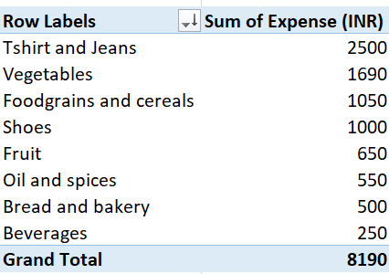
Task 4

Slide 8
How to Save Money Part 2
Task 1 | Task 2 | Task 3 | Task 4 | All
Month-wise trend of expenses (Pivot table and chart) Find out the month Nitin spent the most | Category wise expenses (Pivot table) Visually represent it with data bars to display categories with the highest and lowest expense amount | Month-wise expense of each category (Pivot table) Find out 2 categories with higher expenses for each of the 6 months | How much is spent in each month against different items of Entertainment, Food and Shopping categories Find out which months have the highest amount spent for movies and dining out | Decide on the essential and less essential items and analyse the expenses Recommend how can Nitin increase his savings

Slide 9
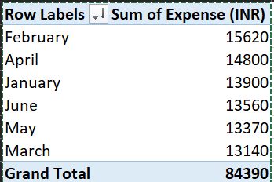
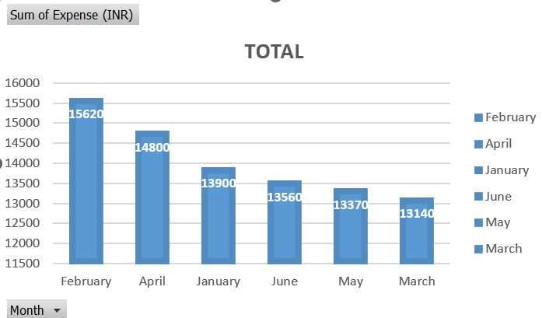
Task 1
As we can see in the table Nitin has spend most in February month

Slide 10
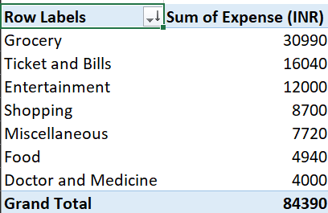
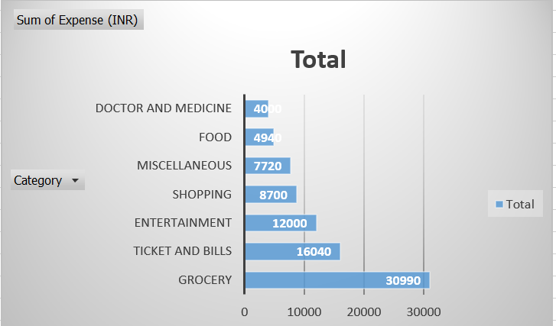
Task 2
As we can see in the table and chart Nitin has spend most in Grocery of amount 30990 and lowest is Doctor and medicine of amount 4000

Slide 11
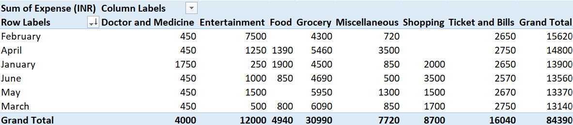
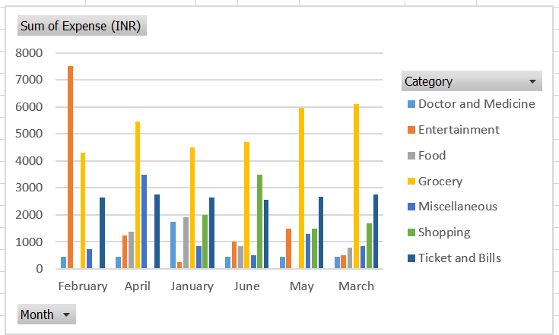
Task 3
As we can see in the table and chart Nitin has spend most in Grocery of amount 30990 and lowest is Doctor and medicine of amount 4000

Slide 12
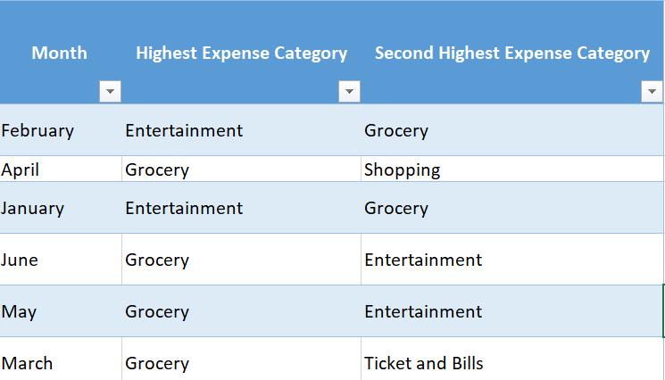
Task 3
The table shows the 2 categories with higher expenses for each of the 6 months

Slide 13
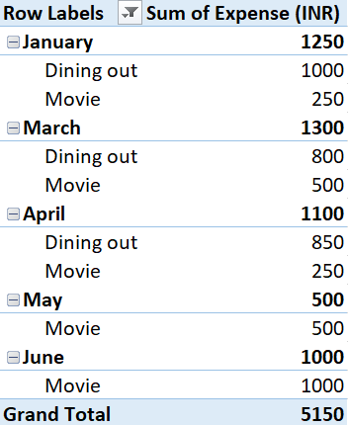
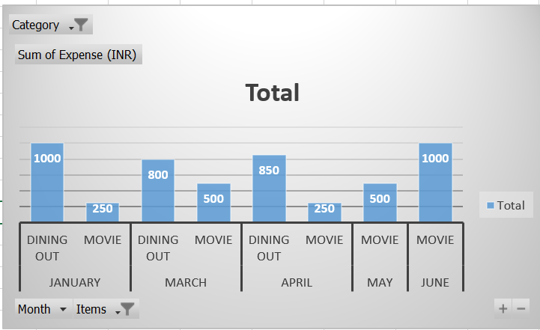
Task 4
As we can see in the table and chart Nitin has spend most in March for Dining out and Movie

Slide 14
Task 5
Essential | Less-Essential
Mother’s Doctor Visit | Dining out
Mother medicine | Movie
Foodgrain and cereals | Chips and fries
Oil and spices | Online Food order
Bread and bakery | Shirts
Vegetables | Shoes
Fruit | Miscellaneous
Gas | Outing with friends
House help
Electricity bill
Railway Monthly Ticket

Slide 15
Task 5
To increase his savings, Nitin should focus on reducing non-essential expenses such as dining out, entertainment, and miscellaneous costs by cooking at home more often, cutting back on movies, and reviewing miscellaneous spending.
He can optimize essential expenses like grocery shopping by planning meals, buying in bulk, and utilizing sales, and reduce utility bills by adopting energy-saving habits.
Tracking expenses regularly, setting specific savings goals, and using budgeting tools are crucial.

Slide 16


